Slide 1
Minnesota Interstate Traffic Volume Analysis Business Intelligence Dashboard Presentation
Name: NIRanjan K C
Towson University / Google BI certificate

Slide 2
Business Question
What are the monthly traffic patterns on Minnesota interstates?
How does traffic vary during different hours of the day?
How do weather conditions affect traffic volume?
Which holidays show the highest traffic levels?
Purpose:
To help transportation planners understand traffic behavior and identify peak traffic conditions.

Slide 3
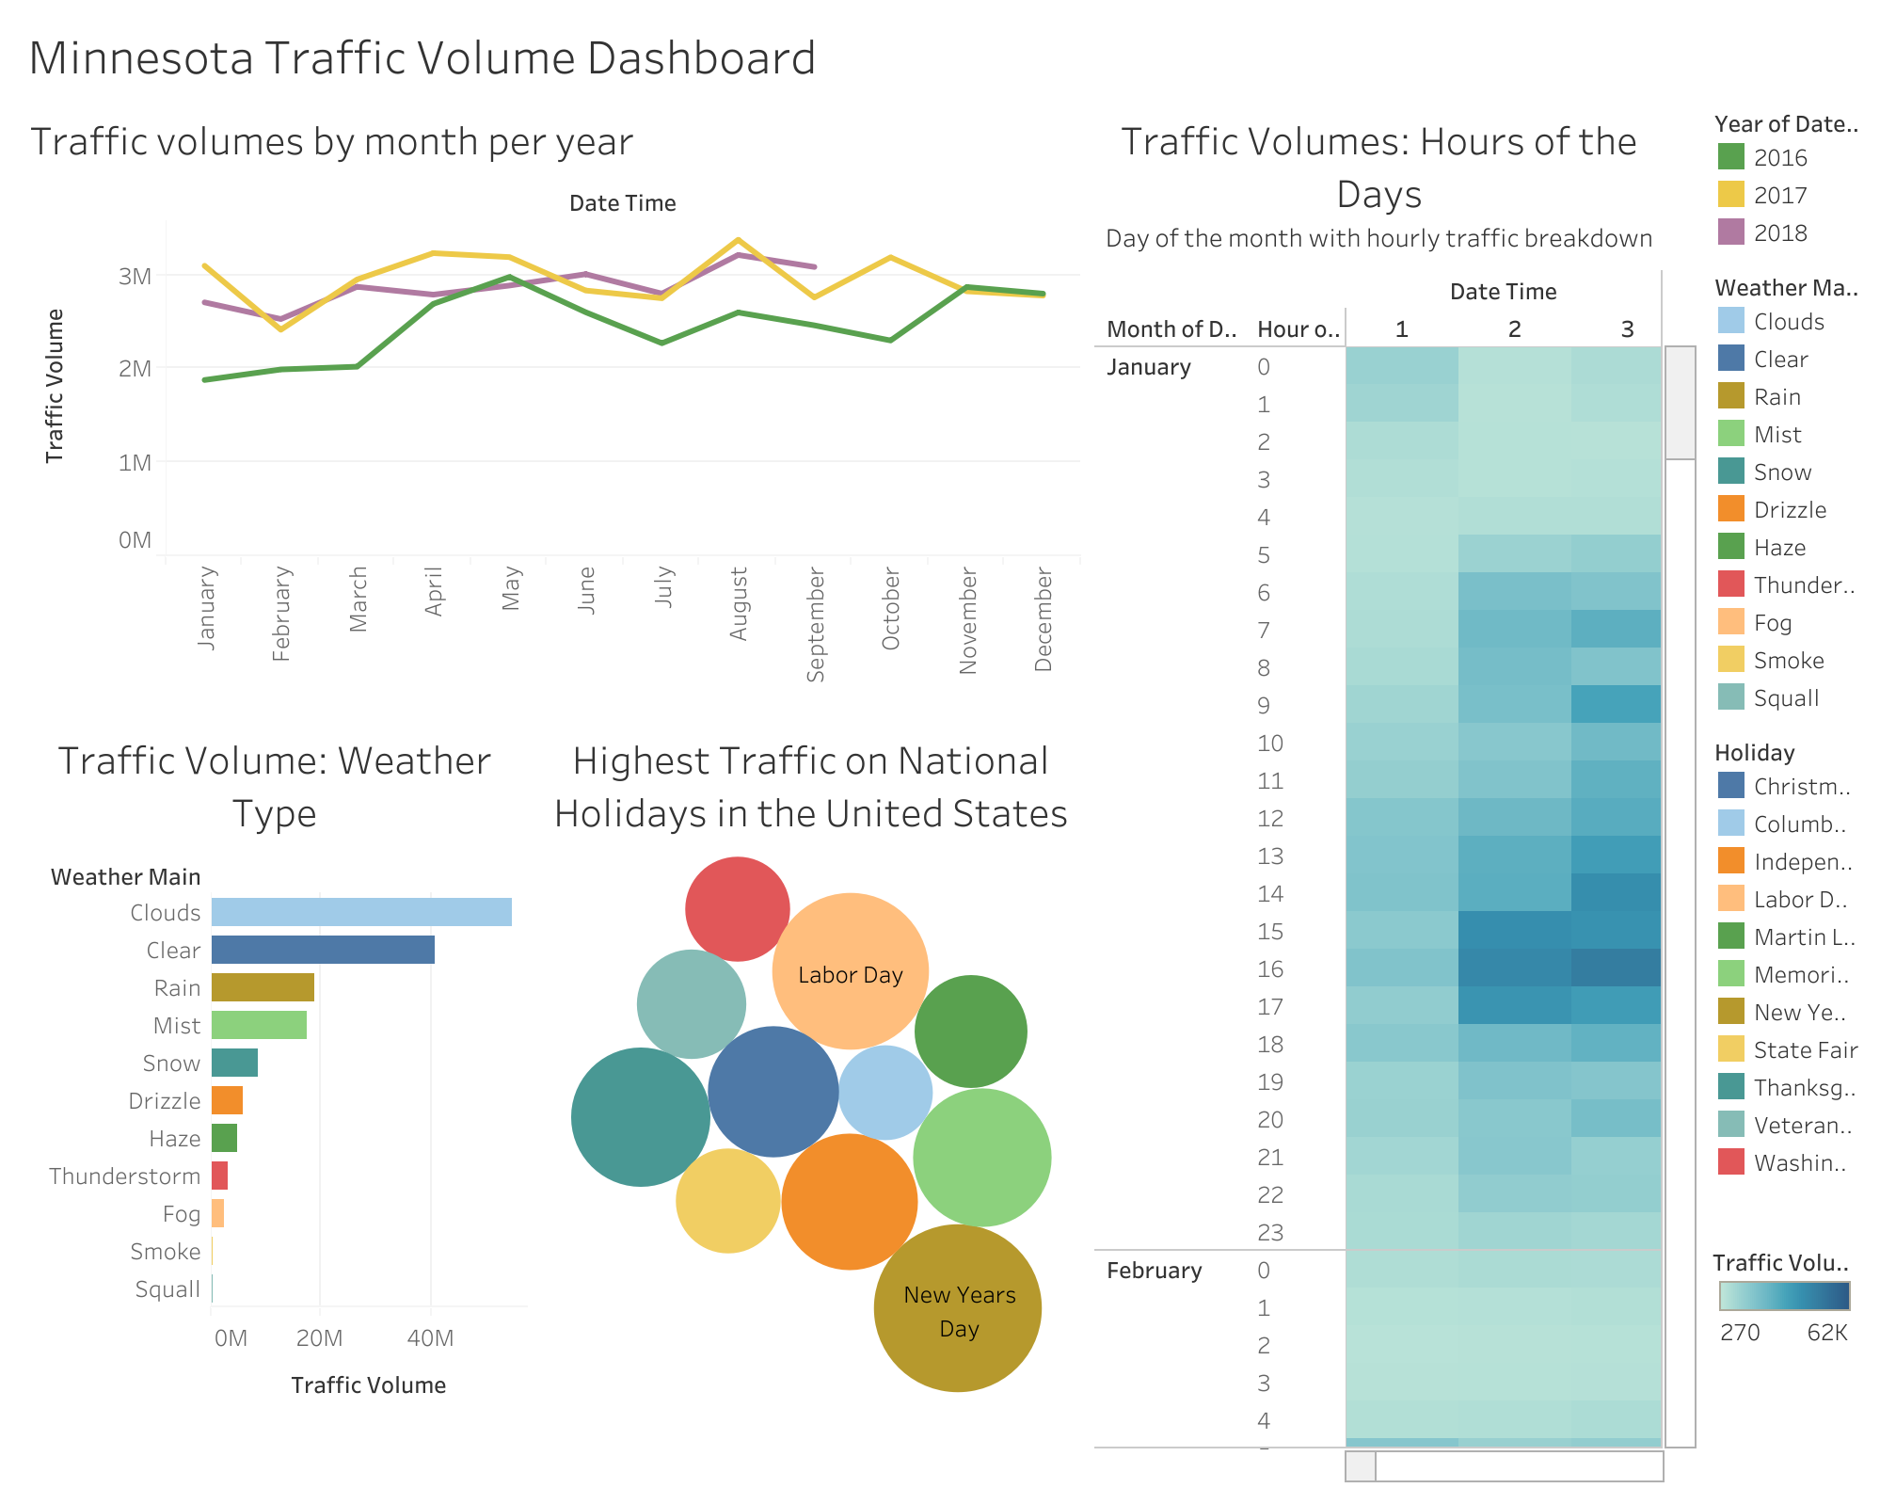
Data & Visualization Methods
Dataset: Minnesota Interstate Traffic Volume dataset
Tool used: Tableau Public
Created dashboard with multiple charts including:
Line chart for monthly traffic trends.
Heatmap for hourly traffic patterns.
Bar chart for weather impact on traffic.
Bubble chart for holiday traffic analysis.
Used filters and interactive elements to explore patterns.

Slide 4
Key Insights from the Dashboard
Traffic volume generally peaks during summer months.
Rush hours (morning and evening) show the highest traffic levels.
Certain holidays like Labor Day experience significantly higher traffic.
Weather conditions such as clear weather tend to have higher traffic compared to heavy precipitation.

Slide 5
Recommendations
Transportation planners can prepare for higher summer traffic demand.
Peak hour congestion may require traffic management strategies.
Holiday travel periods may need additional traffic monitoring.
Weather-related alerts can help manage traffic safety.

